Slide 1
Colombian Milk Price Analysis
Augusto Umaña

Slide 2
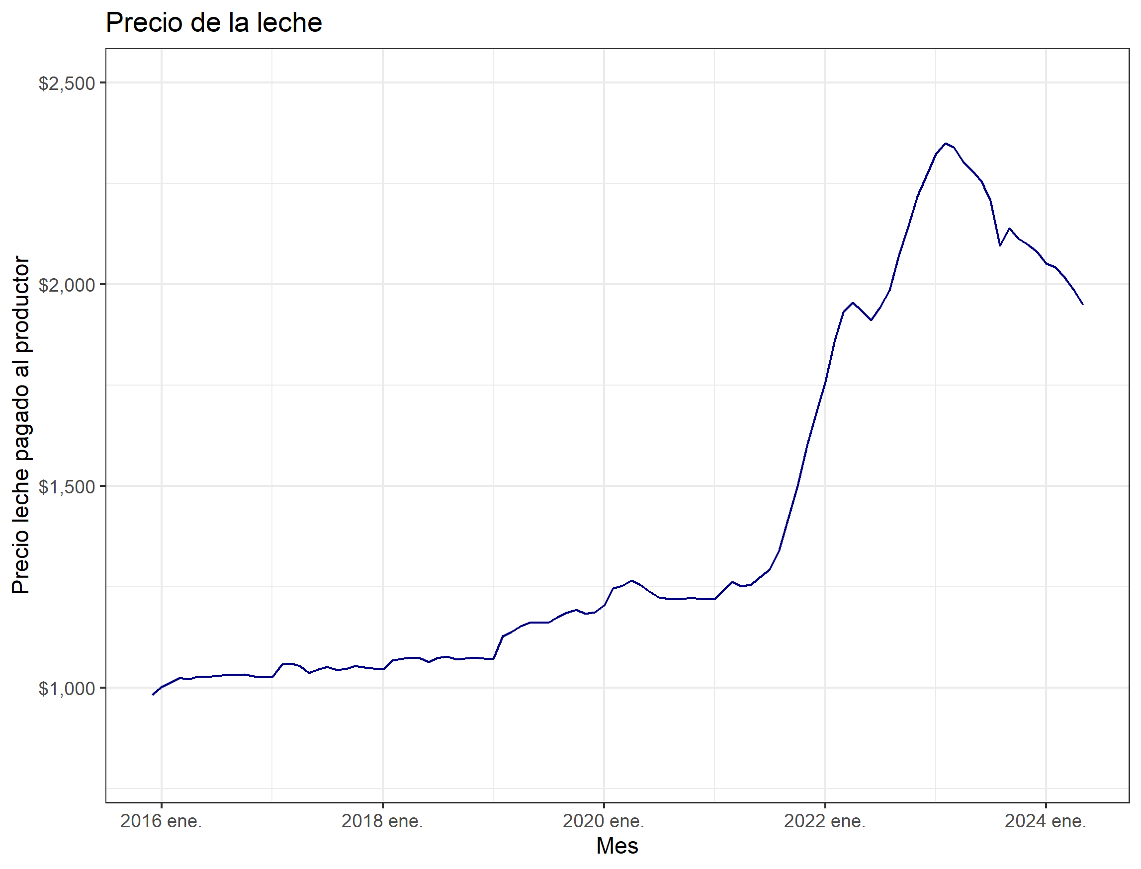
Objective of the Analysis: Understand the key factors driving raw milk price trends
Since 2016, the price of raw milk in Colombia has followed four distinct phases:
2016–2018: Moderate and steady monthly increases A period of gradual growth, likely tied to normal market dynamics and seasonal factors.
2019–2021: Sharper increases with occasional sudden spikes Marked by more volatility, possibly linked to supply disruptions or short-term demand shifts.
2021–2023: Exponential price growth Driven by structural shocks in the agricultural sector, including: • The nationwide strike in May 2021, which disrupted supply chains. • A sharp rise in global input costs (e.g., fertilizers, feed) following the war in Ukraine. • Broader domestic inflation affecting transportation and production costs.
2023–Present: Deflationary phase Characterized by falling input prices, tighter monetary policy, and weakened consumer demand—particularly in dairy categories.

Slide 3
Key Variables Considered in the Analysis
Identifying the main drivers of raw milk price fluctuations
The analysis focused on identifying variables with a direct influence on the price of raw milk:
Input Prices We used data from DANE’s SIPSA system, filtering specifically for agricultural inputs relevant to milk production (e.g., animal feed, fertilizers, supplements).
Demand-Side Variables Raw milk prices are partially driven by consumer demand for liquid milk and dairy products such as cheese and yogurt. To capture this dynamic, we used the Monthly Manufacturing Survey (EMM) from DANE, which reports monthly production and sales across manufacturing sectors, including dairy processing.
Inflation Indicators Given the inflationary pressures between 2021 and 2023, we included key inflation metrics: • CPI (Consumer Price Index) • CPI for milk and cheese • Agricultural PPI (Producer Price Index)

Slide 4
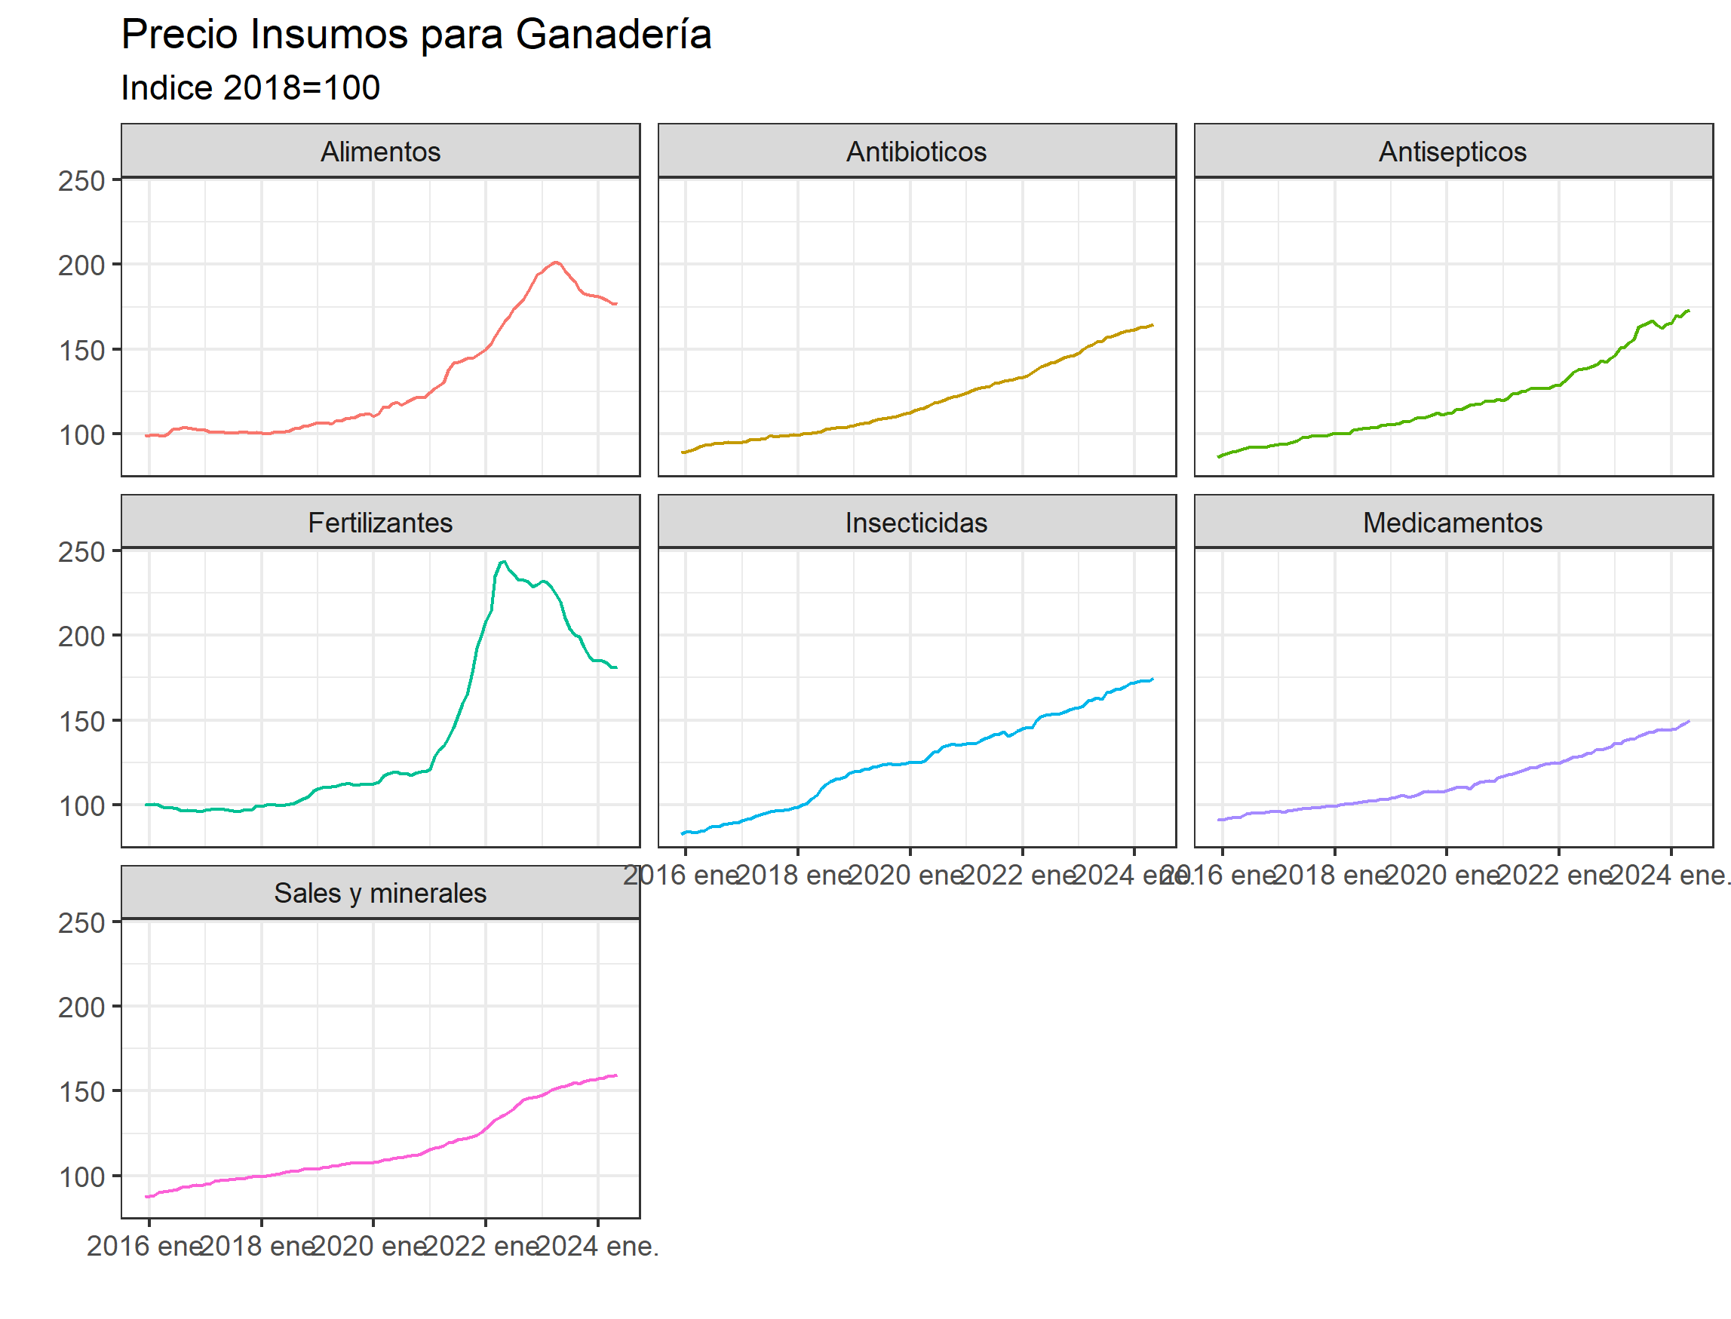
Input Prices
SIPSA Data – Agricultural Input Cost Monitoring
Input price data was sourced from SIPSA (the Agricultural Sector Price and Supply Information System), managed by DANE. This system tracks monthly price variations across the entire agricultural supply chain.
For this analysis, we selected only those inputs directly related to raw milk production and grouped them into seven main categories to facilitate interpretation and modeling.

Slide 5
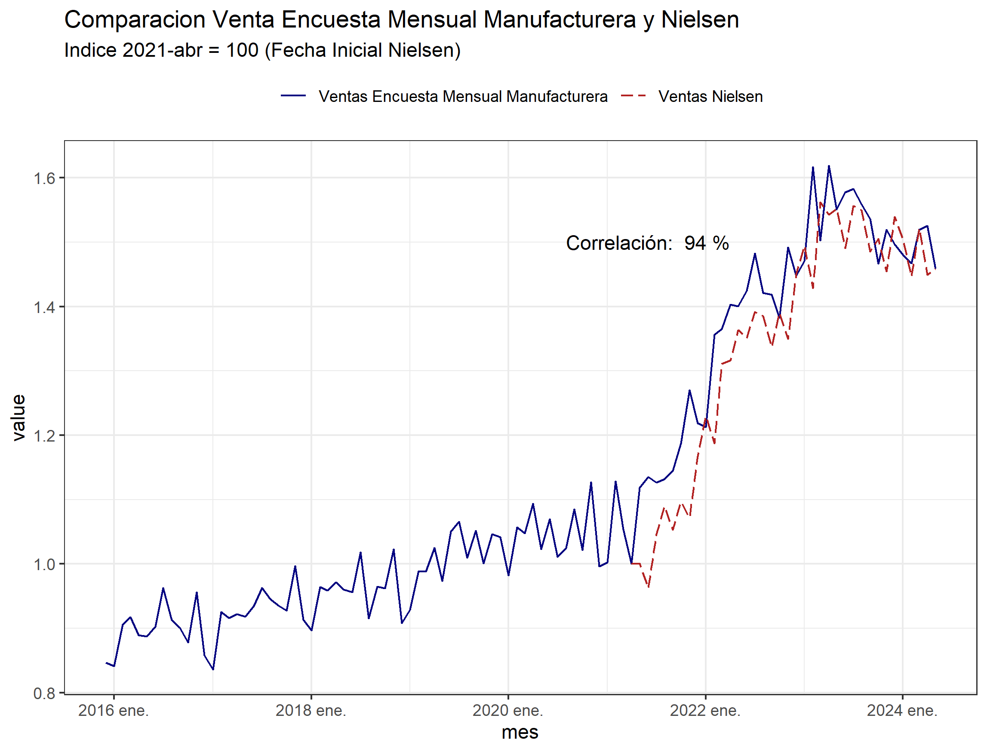
Demand Variables
Capturing Dairy Sector Activity through Official Manufacturing Data
To model demand-side dynamics, we used data from the Monthly Manufacturing Survey (EMM), specifically the dairy sector chapter. This survey tracks monthly production and sales volumes across all sectors of the economy and provides a long historical series (available since January 2001).
For our purposes, it offers a comprehensive view of the output of dairy products and their derivatives (e.g., cheese, yogurt, condensed milk), making it a robust proxy for downstream demand.
While Nielsen data is also available, it presents two key limitations: - It only covers the last three years. - It focuses exclusively on the liquid milk segment, and only for the specific sales channels accessed by Alquería.

Slide 6
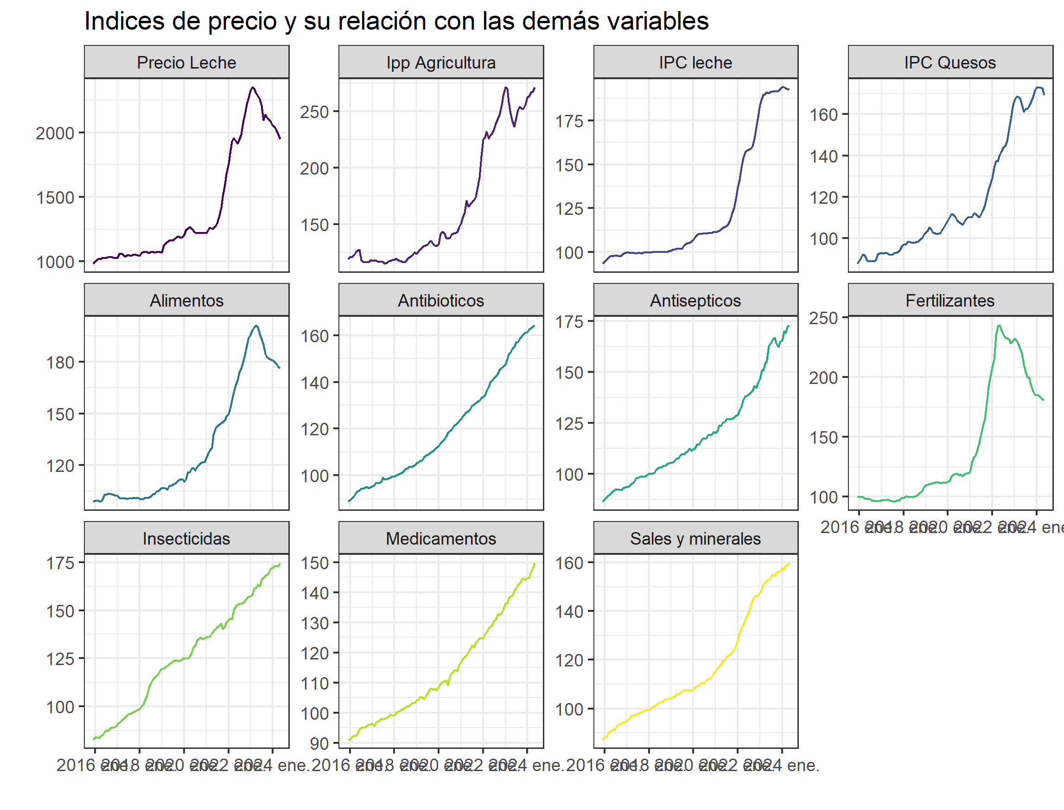
Inflation Variables
Controlling for Price Level Effects through Deflation and Differencing
All price-related variables show high correlation—both in their overall trend and their shape over time. This strong co-movement reflects the broad inflationary dynamics affecting the economy.
To isolate the true drivers of raw milk price behavior, we applied two standard data transformations:
Deflation: All monetary variables were converted to real terms (constant prices) to remove the effects of general inflation.
Differencing: We used changes in prices (month-over-month differences) rather than absolute levels, since what truly matters is the variation in input costs and demand—not their nominal value.
These transformations help ensure a more accurate and meaningful analysis.

Slide 7
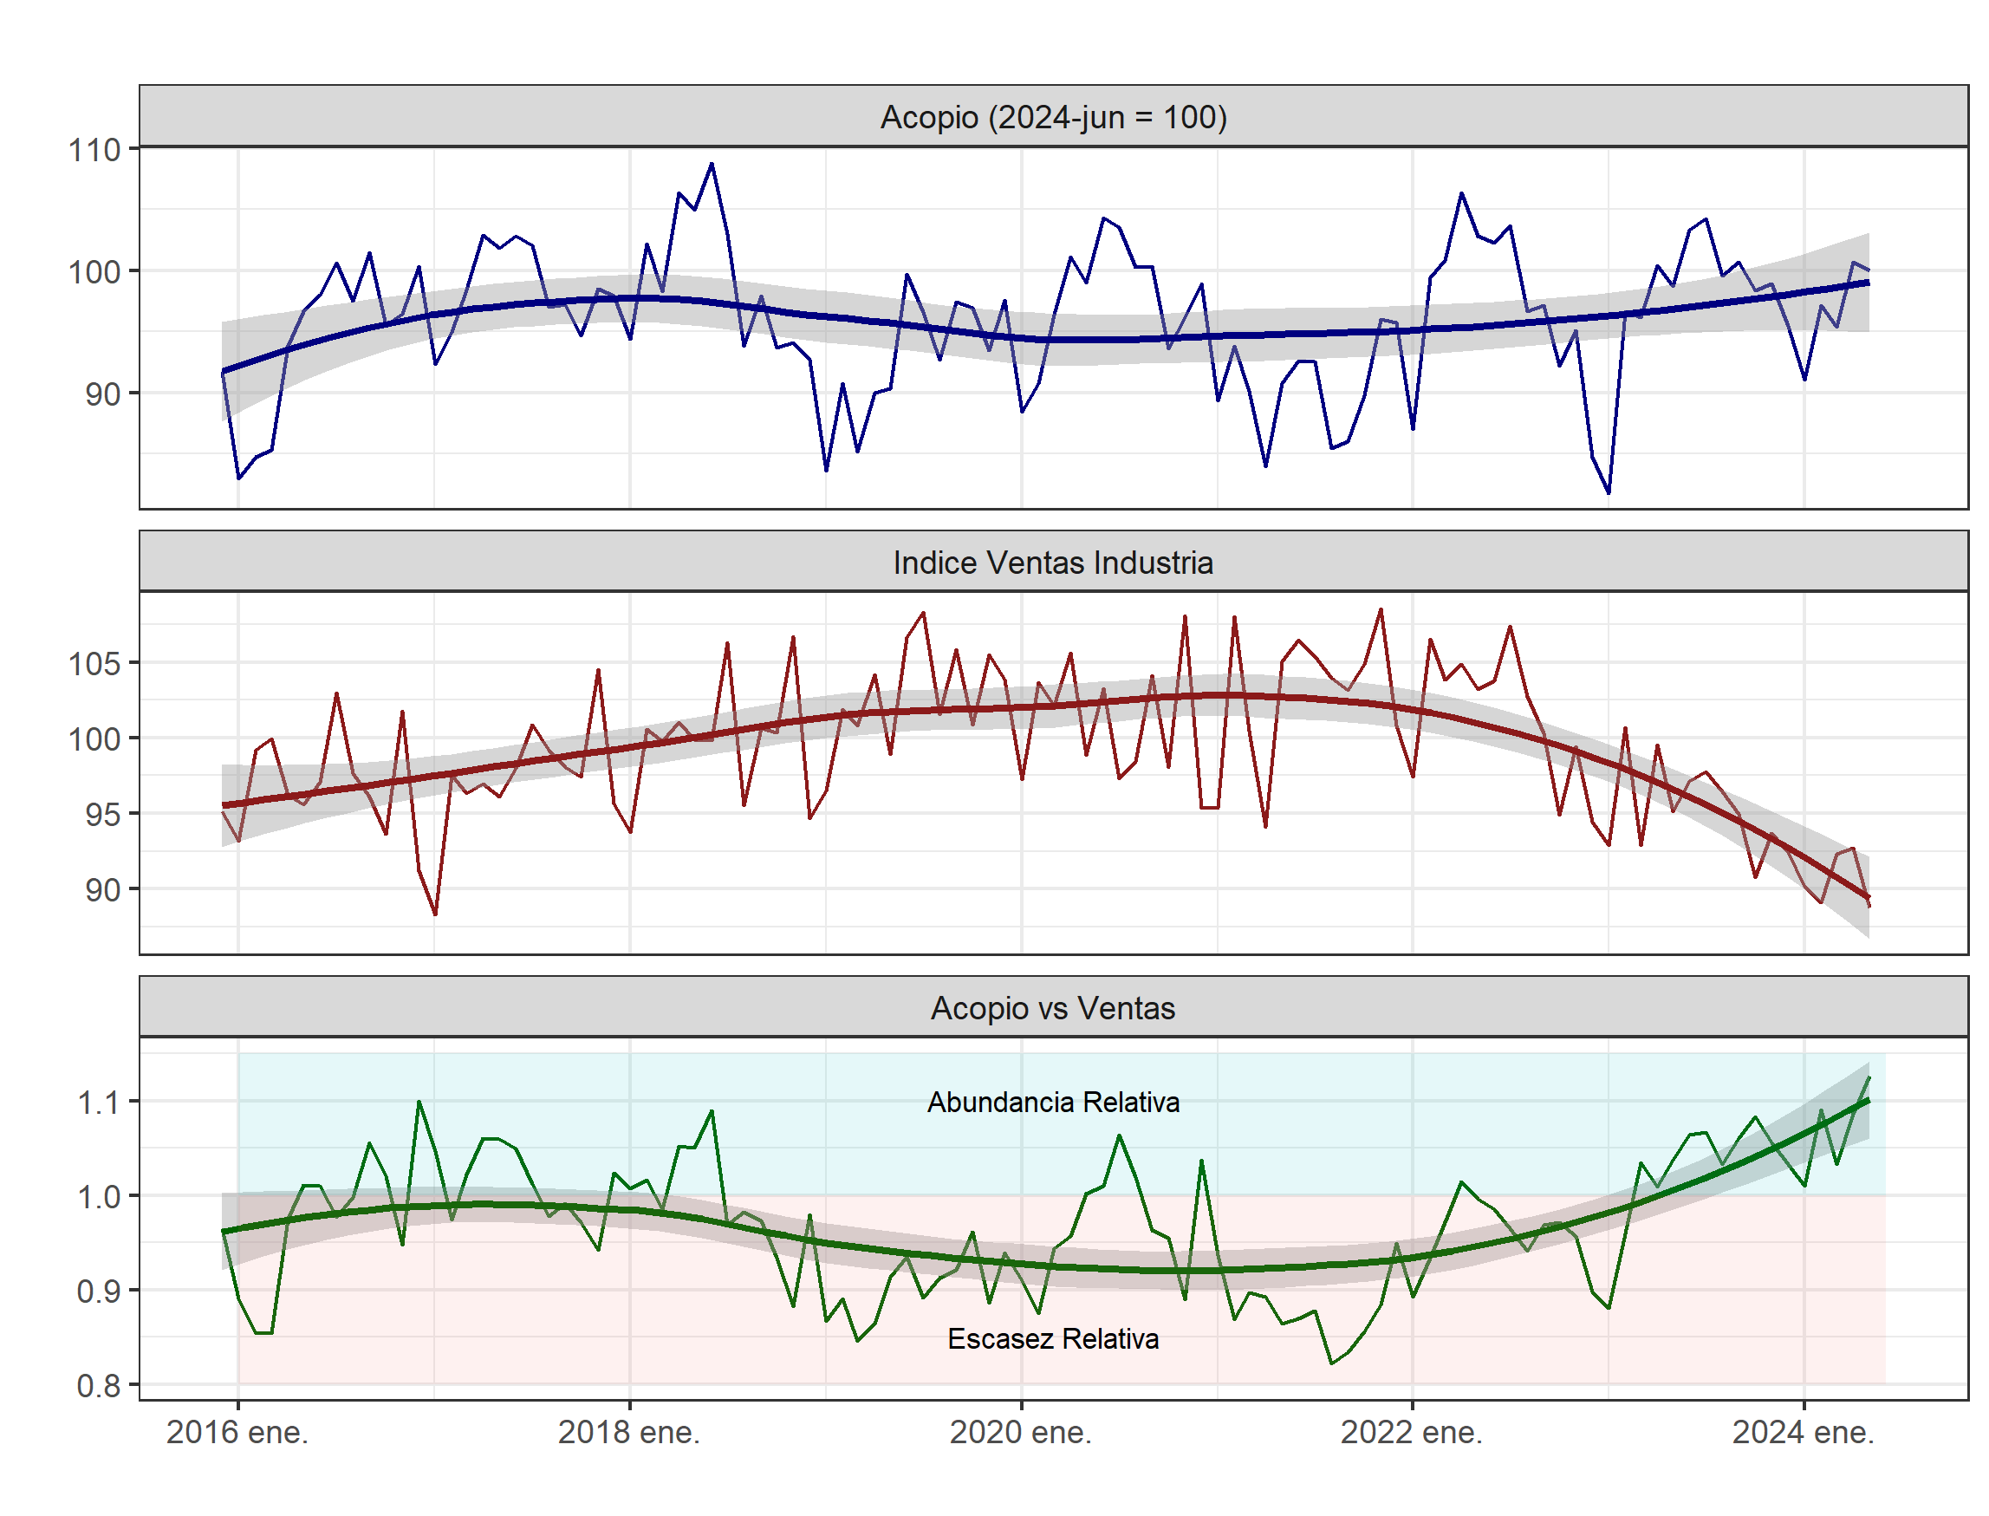
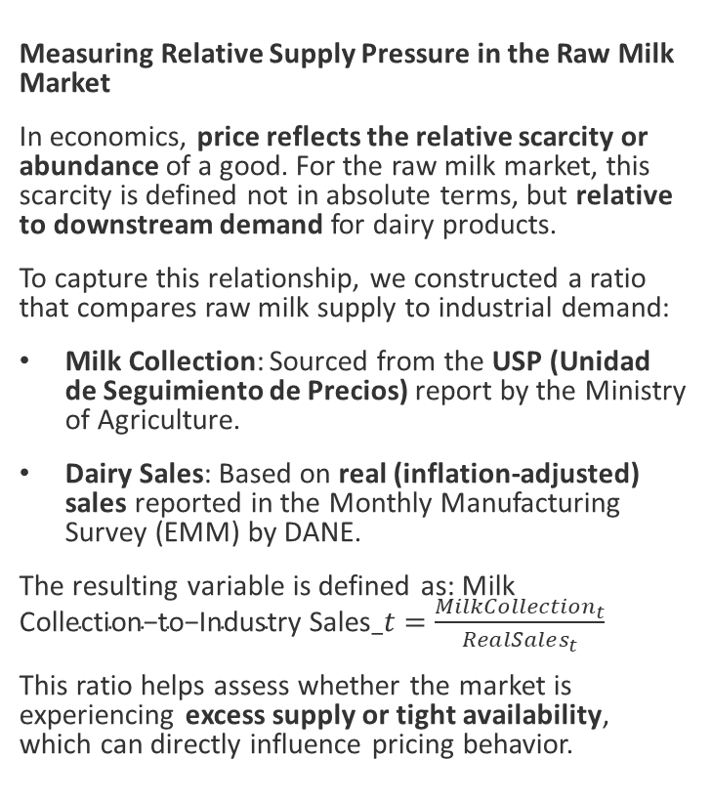
Constructed Variable: Milk Collection-to-Sales Ratio
Measuring Relative Supply Pressure in the Raw Milk Market
In economics, price reflects the relative scarcity or abundance of a good. For the raw milk market, this scarcity is defined not in absolute terms, but relative to downstream demand for dairy products.
To capture this relationship, we constructed a ratio that compares raw milk supply to industrial demand:
Milk Collection: Sourced from the USP (Unidad de Seguimiento de Precios) report by the Ministry of Agriculture.
Dairy Sales: Based on real (inflation-adjusted) sales reported in the Monthly Manufacturing Survey (EMM) by DANE.
The resulting variable is defined as: $\text{Milk} \text{Collection}\text{−}\text{to}\text{−}\text{Industry} \text{Sales}_t=\frac{MilkCollection_{t}}{RealSales_{t}}$
This ratio helps assess whether the market is experiencing excess supply or tight availability, which can directly influence pricing behavior.

Slide 8
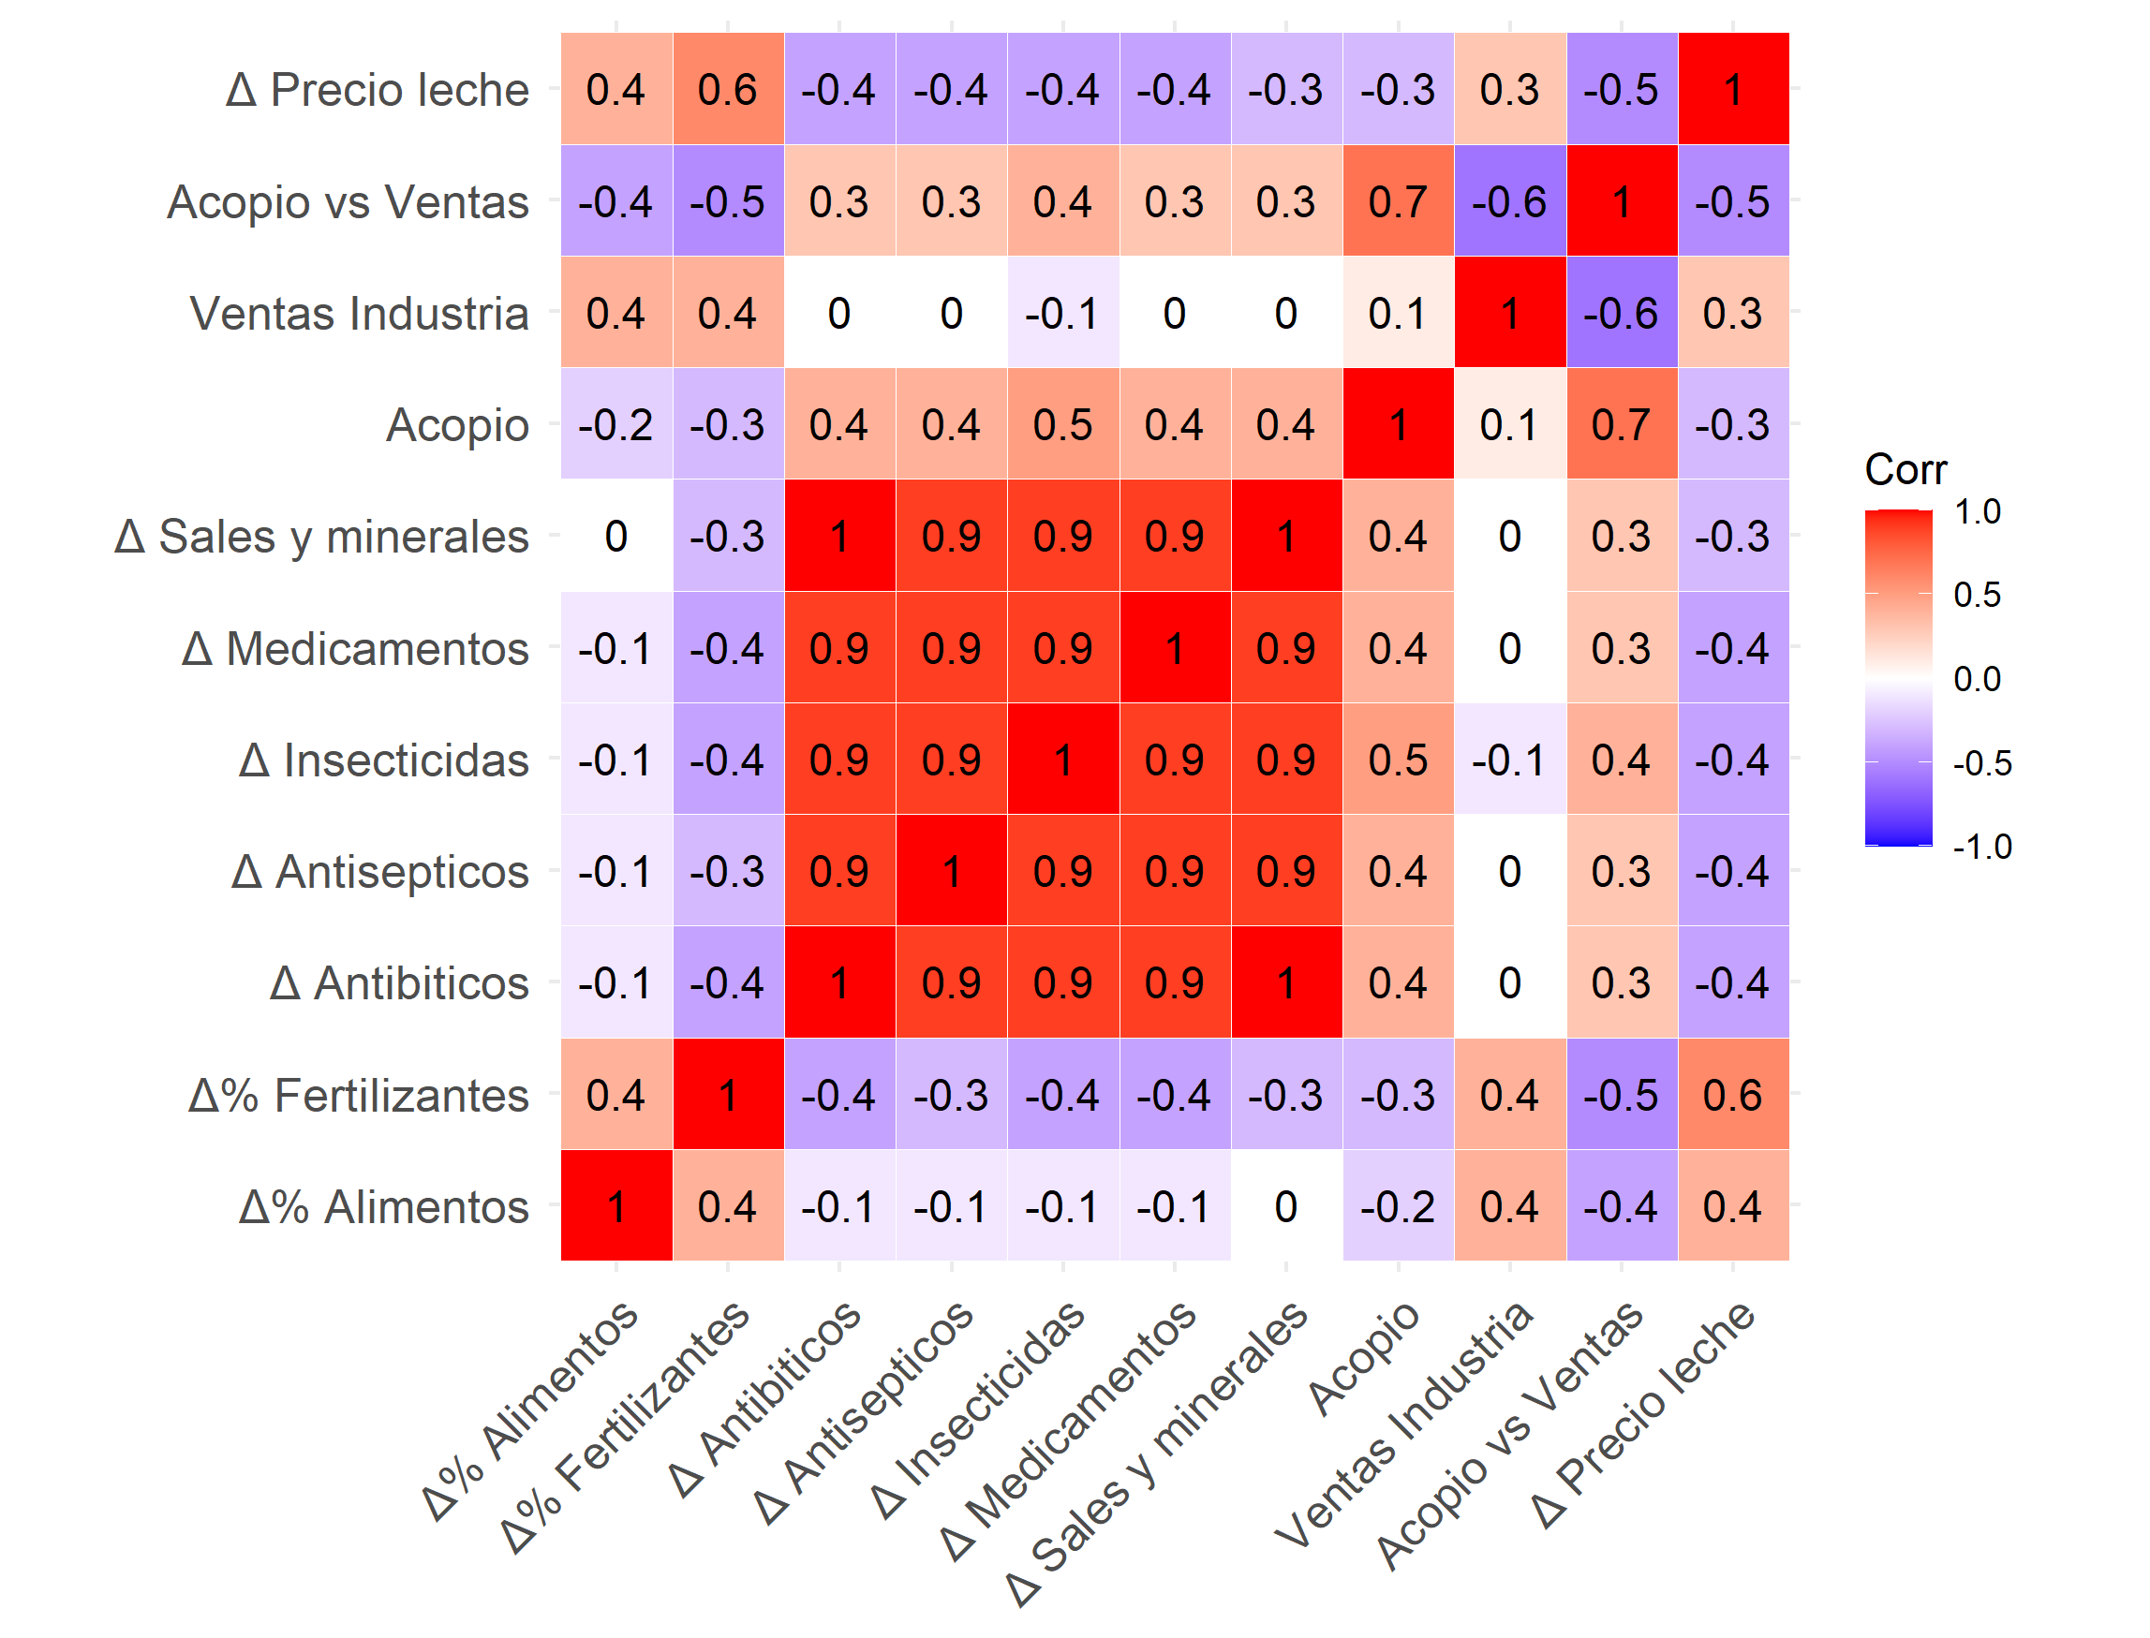
Correlation Challenges: Multicollinearity
Navigating variable redundancy and spurious results
The initial analysis considered more than 190 variables. After variable selection and refinement, we identified 10 key drivers that best explain raw milk price behavior.
However, several of these variables are highly correlated with each other, raising issues of multicollinearity:
Industry Sales, Milk Collection Volume, and the Collection-to-Sales Ratio all show strong correlations with raw milk price—but are also strongly correlated among themselves.
Changes in input prices (month-over-month) also exhibit high inter-correlation, particularly among similar categories (e.g., different types of feed and supplements). This can lead to spurious results in modeling and weaken interpretability.
Despite this, two input price variables stand out: - Percent change in fertilizer prices - Percent change in feed prices
Both show strong correlation with raw milk prices and low correlation with other input variables, making them more reliable predictors in the model.

Slide 9
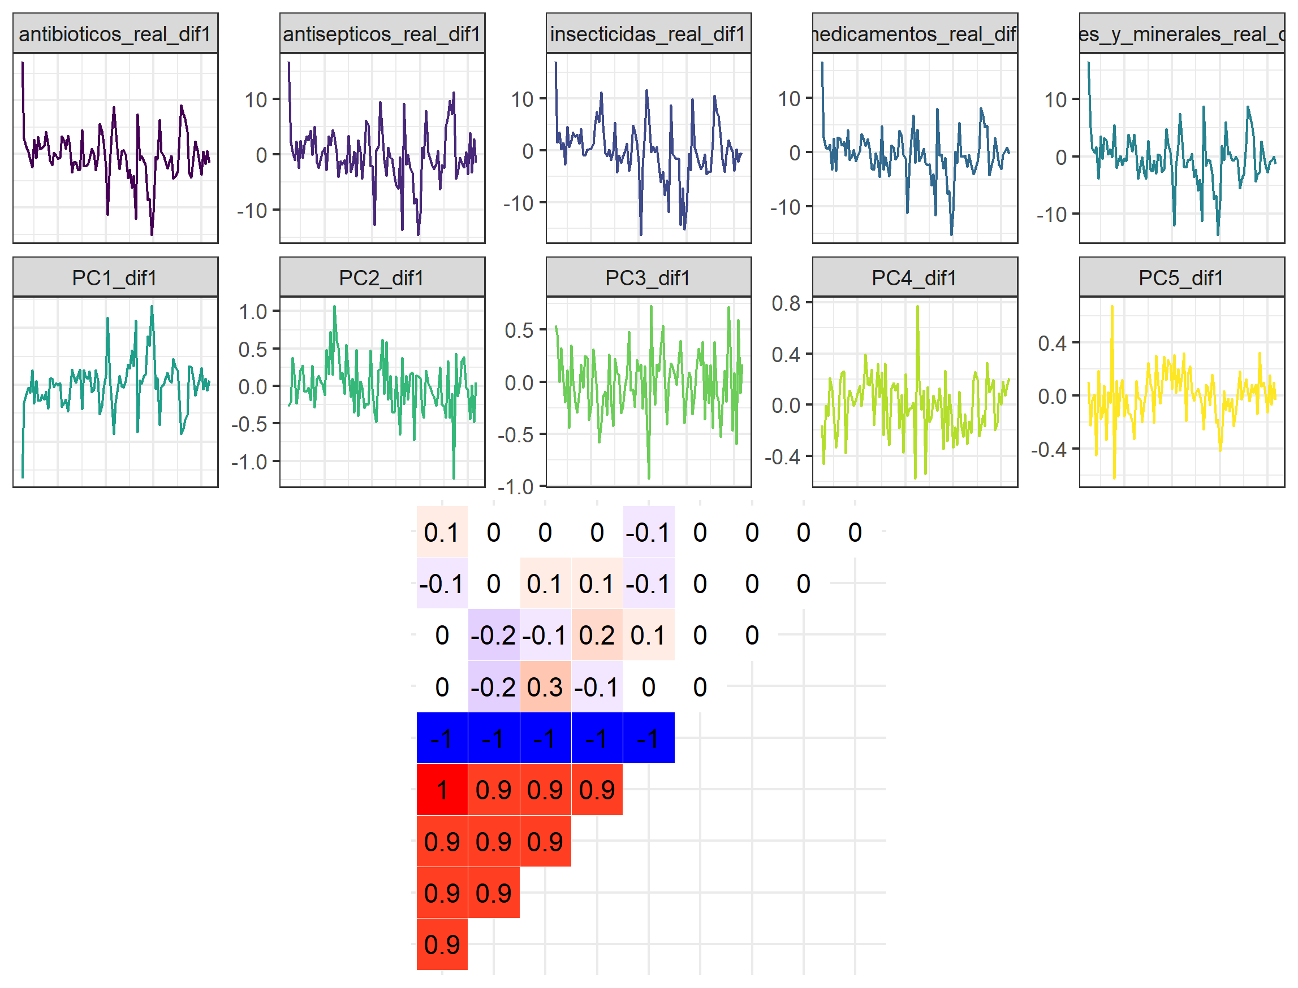
Addressing Correlation Issues: Principal Component Analysis (PCA)
Reducing input price redundancy through dimensionality reduction
To address the multicollinearity problem among input price variables, we applied Principal Component Analysis (PCA).
PCA transforms the original variables into new, uncorrelated components that retain the majority of the original information. Each principal component is a linear combination of the original variables and satisfies two key conditions:
Independence: The components are uncorrelated with each other.
Variance Maximization: Each component captures the maximum possible variance (i.e., information) from the data.
In the chart, we observe that the first principal component (PC1_dif1) captures 96% of the total variance from the five original variables. This makes it a highly efficient summary of the dynamics in input price changes, and a robust input for modeling.

Slide 10
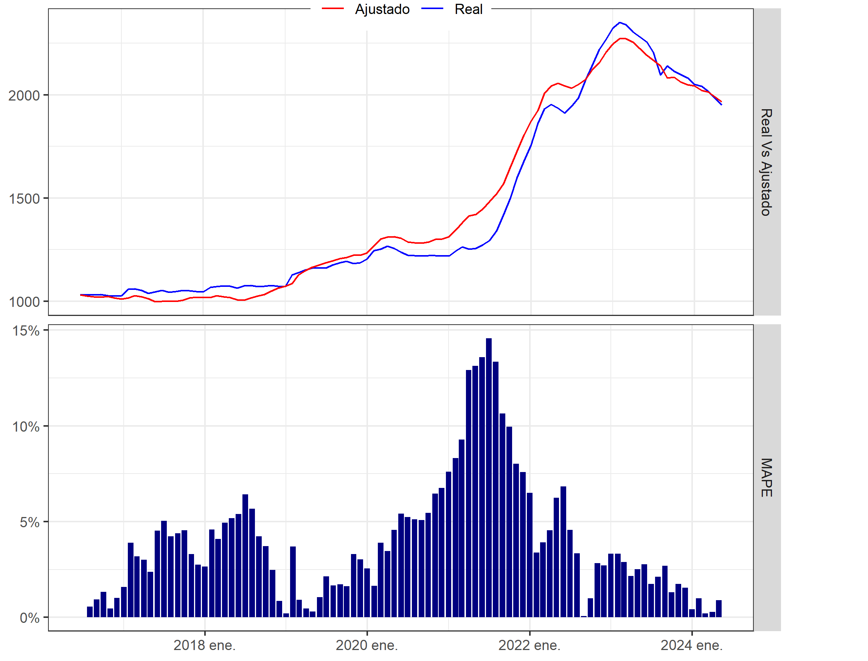
Model Fit
Explaining price movements through a linear regression model
To explain the variation in raw milk prices, we estimated a linear regression model using the monthly change in price as the dependent variable. The model includes:
Two lags of the price change, to capture autocorrelation and short-term dynamics.
Exogenous explanatory variables, selected based on economic reasoning and statistical performance:
Milk Collection-to-Sales Ratio
Percent change in fertilizer prices
First principal component summarizing the remaining input prices
This specification balances interpretability with predictive power and controls for multicollinearity through PCA.

Slide 11
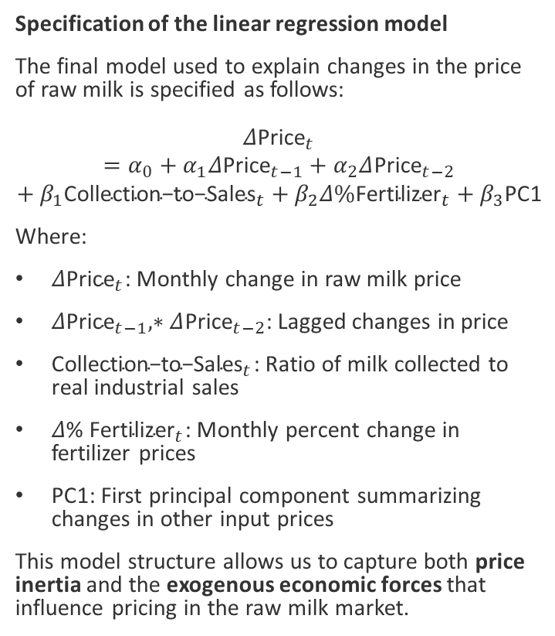
Fitted Model
Specification of the linear regression model
The final model used to explain changes in the price of raw milk is specified as follows:
$$Δ{\text{Price}}_{t}=α_{0}+α_{1}Δ{\text{Price}}_{t−1}+α_{2}Δ{\text{Price}}_{t−2}+β_{1}{\text{Collection}\text{−}\text{to}\text{−}\text{Sales}}_{t}+β_{2}Δ\%{\text{Fertilizer}}_{t}+β_{3}\text{PC}\text{1}$$
Where:
$Δ{\text{Price}}_{t}$: Monthly change in raw milk price
$Δ{\text{Price}}_{t−1},∗Δ{\text{Price}}_{t−2}$: Lagged changes in price
${\text{Collection}\text{−}\text{to}\text{−}\text{Sales}}_{t}$: Ratio of milk collected to real industrial sales
$Δ{\text{\% }\text{Fertilizer}}_{t}$: Monthly percent change in fertilizer prices
$\text{PC}\text{1}$: First principal component summarizing changes in other input prices
This model structure allows us to capture both price inertia and the exogenous economic forces that influence pricing in the raw milk market.
 | precio dif 1
Predictors | Estimates | Statistic | p
(Intercept) | 80.43 | 2.00 | 0.048
precio dif1 lag 1 | 0.48 | 5.75 | <0.001
acopio vs ventas industria | -79.82 | -1.96 | 0.053
precio pct fertilizantes | 292.30 | 2.17 | 0.033
PC1 dif1 | 1.75 | 1.48 | 0.142
Observations | 95
R² / R² adjusted | 0.568 / 0.549

Slide 12
Simulation Results

Slide 13
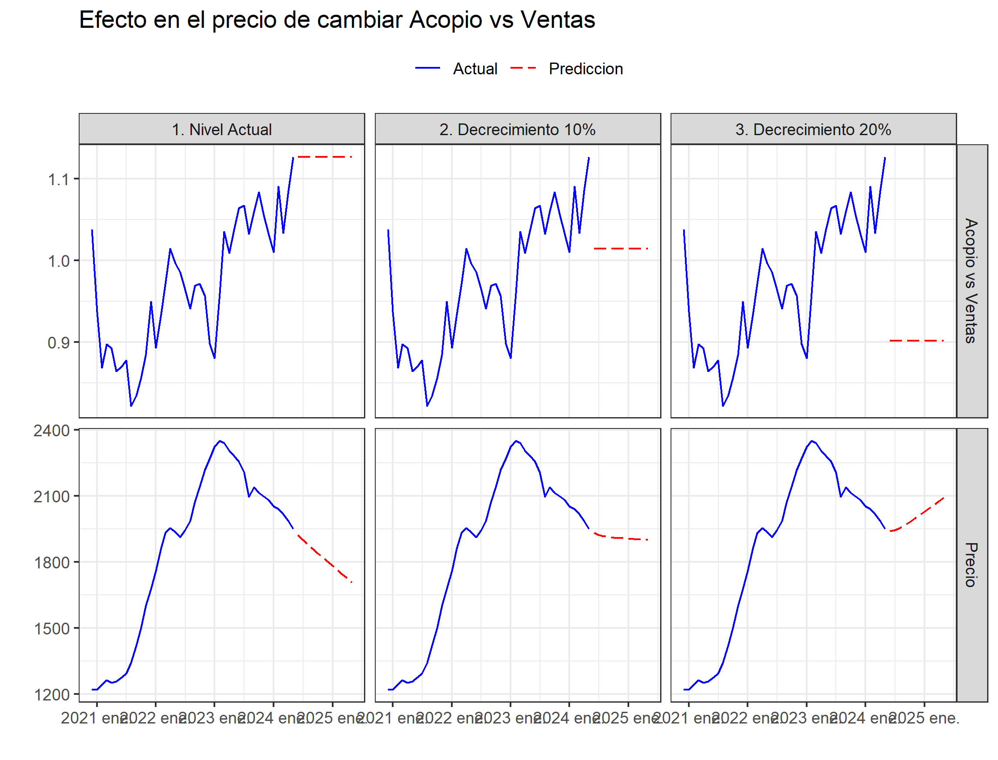
Impulse-Response: Milk Collection-to-Sales Ratio
We performed a simulation to analyze how different levels of the Collection-to-Sales Ratio affect raw milk price over time, assuming other factors remain constant.
Key scenarios:
Current situation maintained (collection-to-sales remains at current level): → Price converges to approximately COP 1,665
Improved balance in the market (ratio reaches 1): → Price stabilizes at the current level of COP 1,870
Milk shortage scenario (due to reduced collection or stronger demand from industry): → Price increases and stabilizes around COP 2,076
This simulation highlights the sensitivity of price to supply-demand balance in the raw milk market and underscores the role of commercial demand dynamics in price formation.

Slide 14
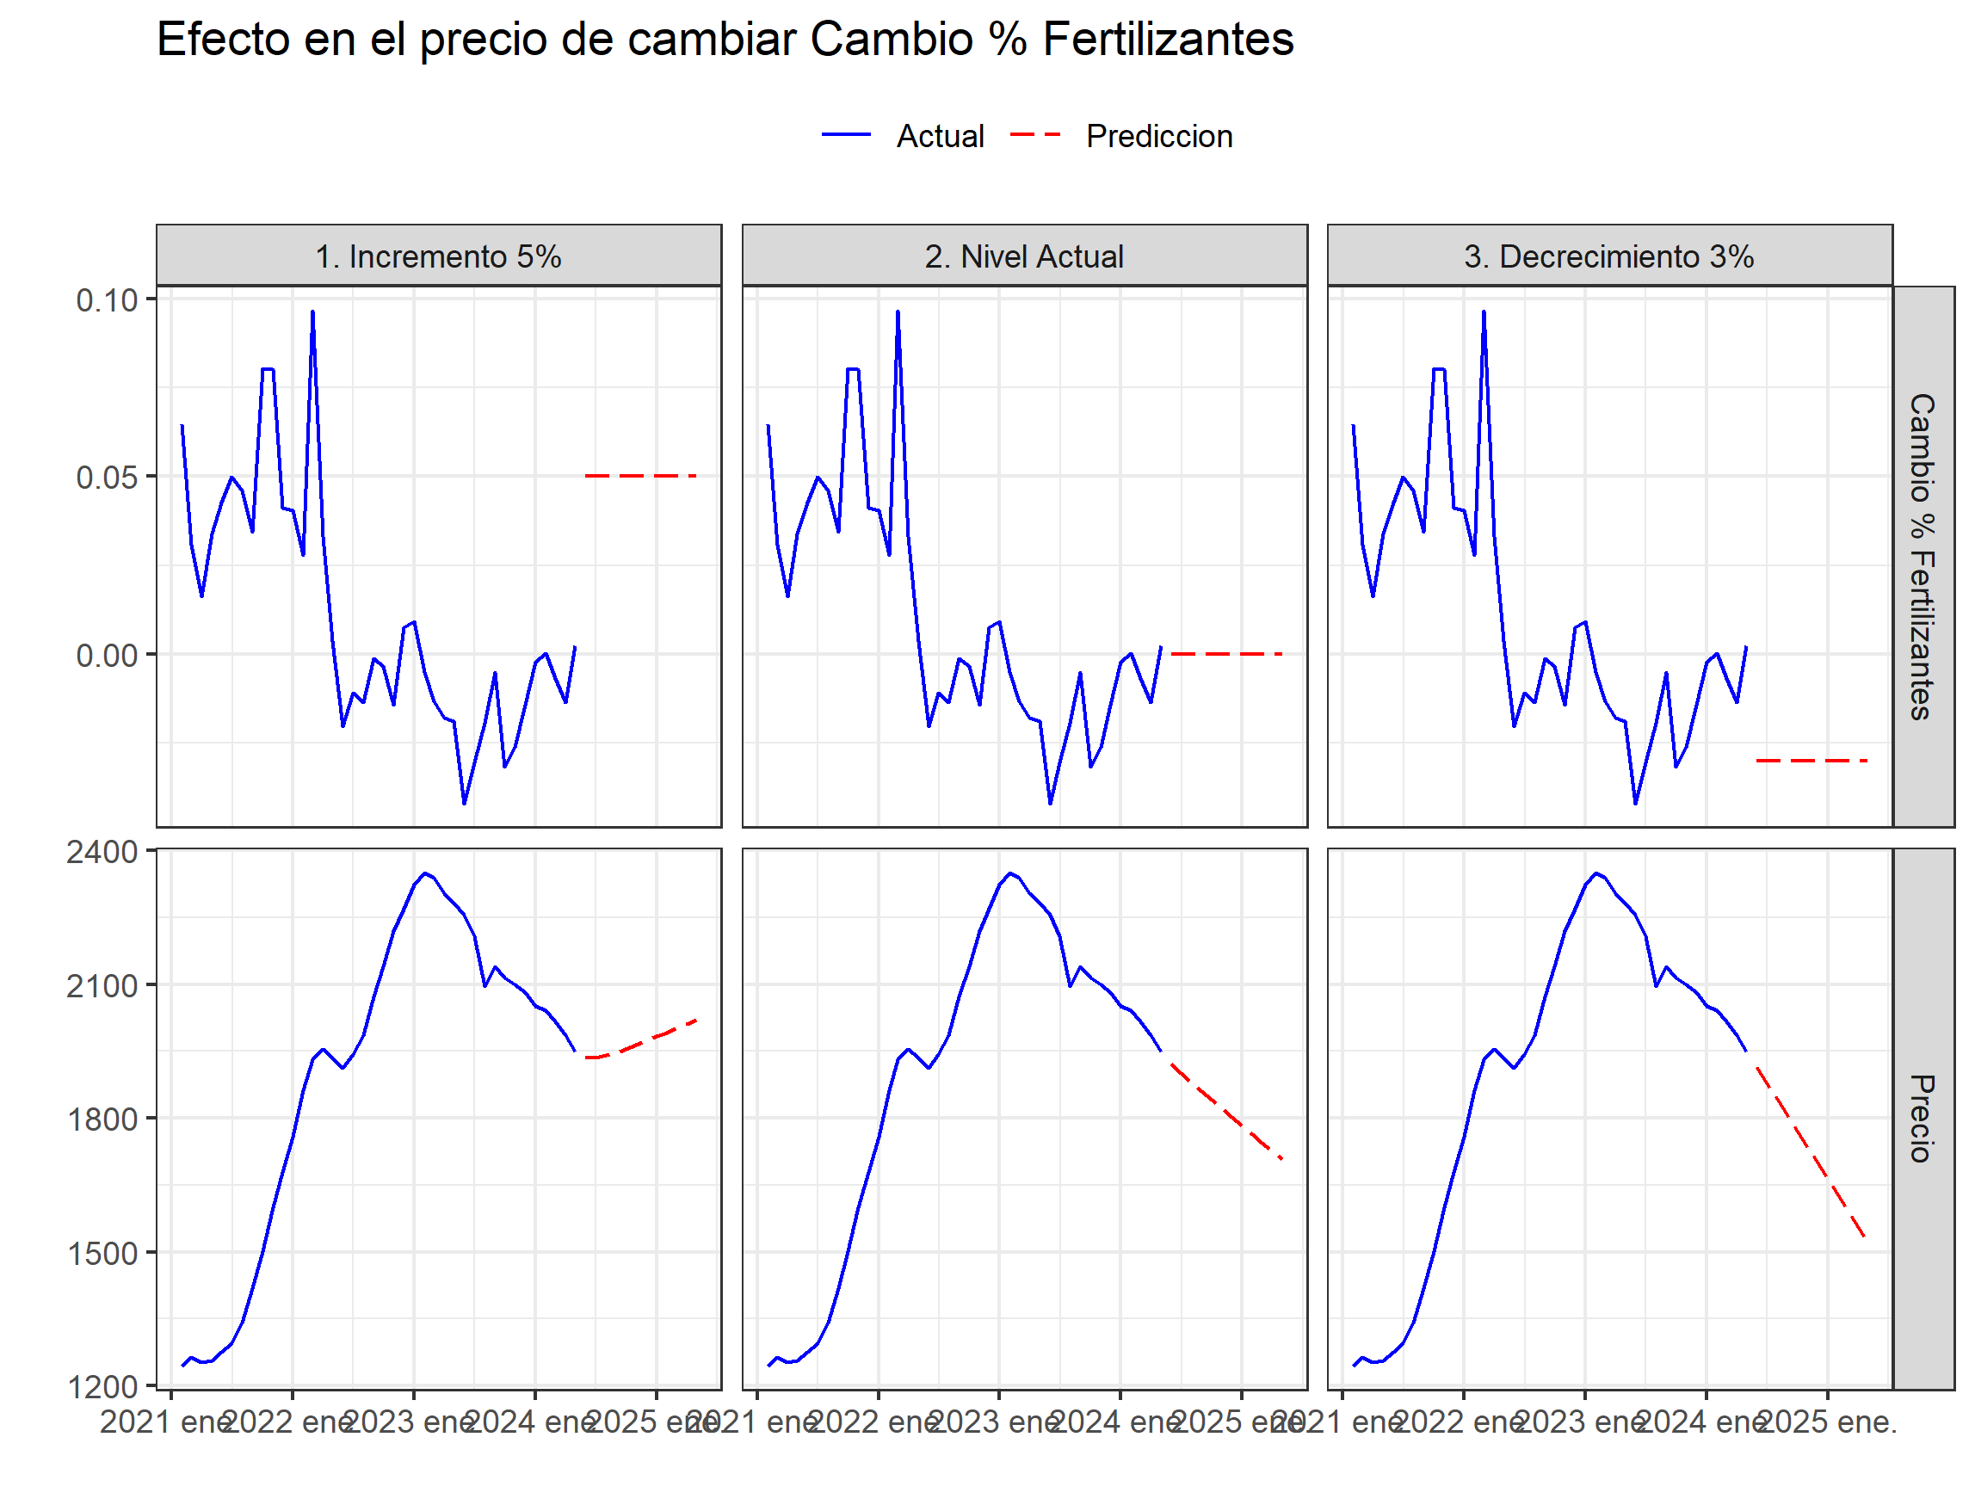
Simulation Results
Impulse-Response: Fertilizer Prices
We simulated the effect of different fertilizer price scenarios on the future trajectory of raw milk prices, holding other variables constant.
Key scenarios:
+5% increase in fertilizer prices (similar to 2021–2022 surge): → Milk price stabilizes around COP 1,956, halting the current downward trend.
No change in fertilizer prices (status quo): → Milk price continues its decline, reaching approximately COP 1,665 within a year.
Decrease in fertilizer prices: → Milk price drops further and stabilizes near COP 1,490
These results confirm the strong short-term pass-through from input cost shocks—particularly fertilizers—into raw milk pricing dynamics.

Slide 15
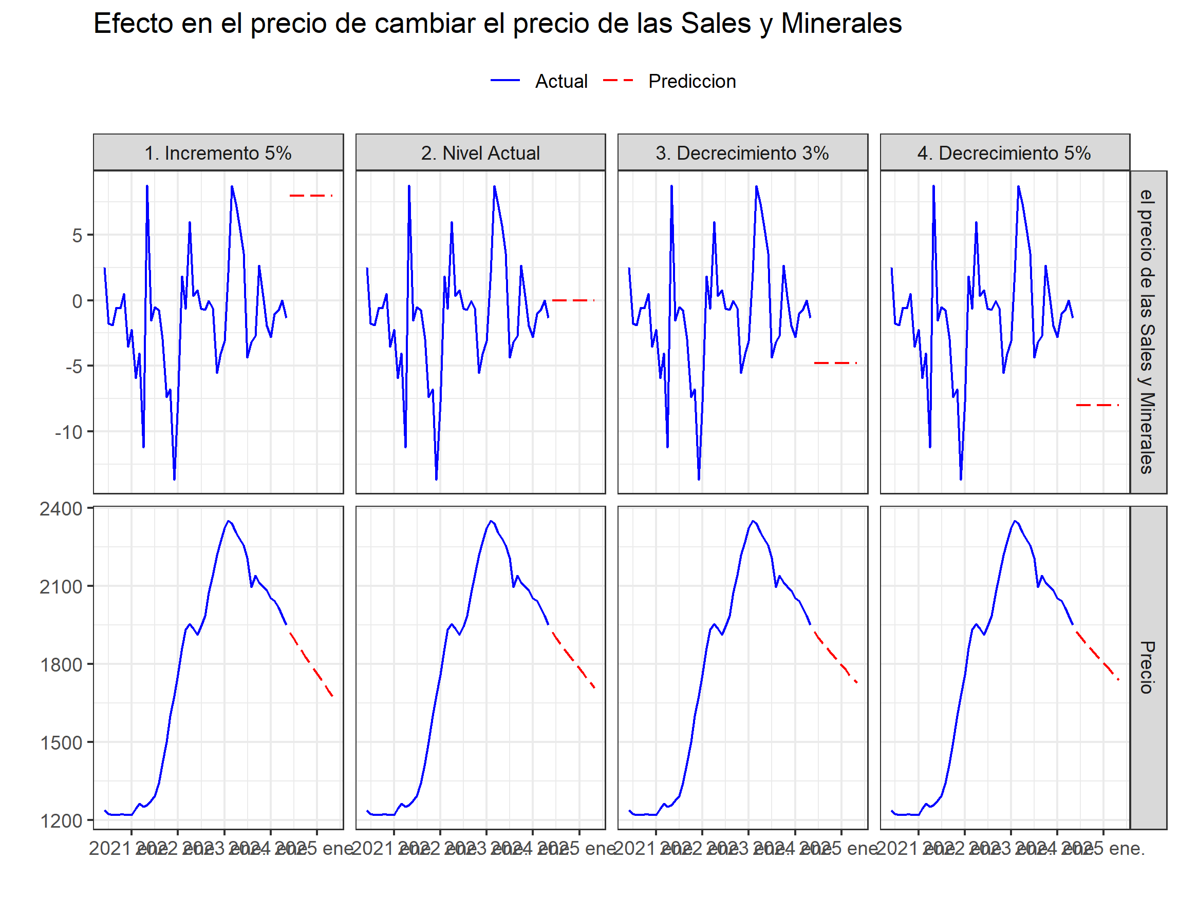
Simulation Results
Impulse-Response: Antibiotic Prices (and Other Inputs)
We evaluated the impact of small fluctuations in antibiotic prices—representative of other secondary inputs—on raw milk prices.
Key findings:
For changes in the range of −5% to +5% in antibiotic prices: → The impact on raw milk price is limited.
Within this range, the milk price varies only from COP 1,628 to COP 1,701
This suggests that while antibiotics and similar inputs do contribute to production costs, their isolated short-term influence on price dynamics is relatively low compared to primary inputs like fertilizers or feed.

Slide 16
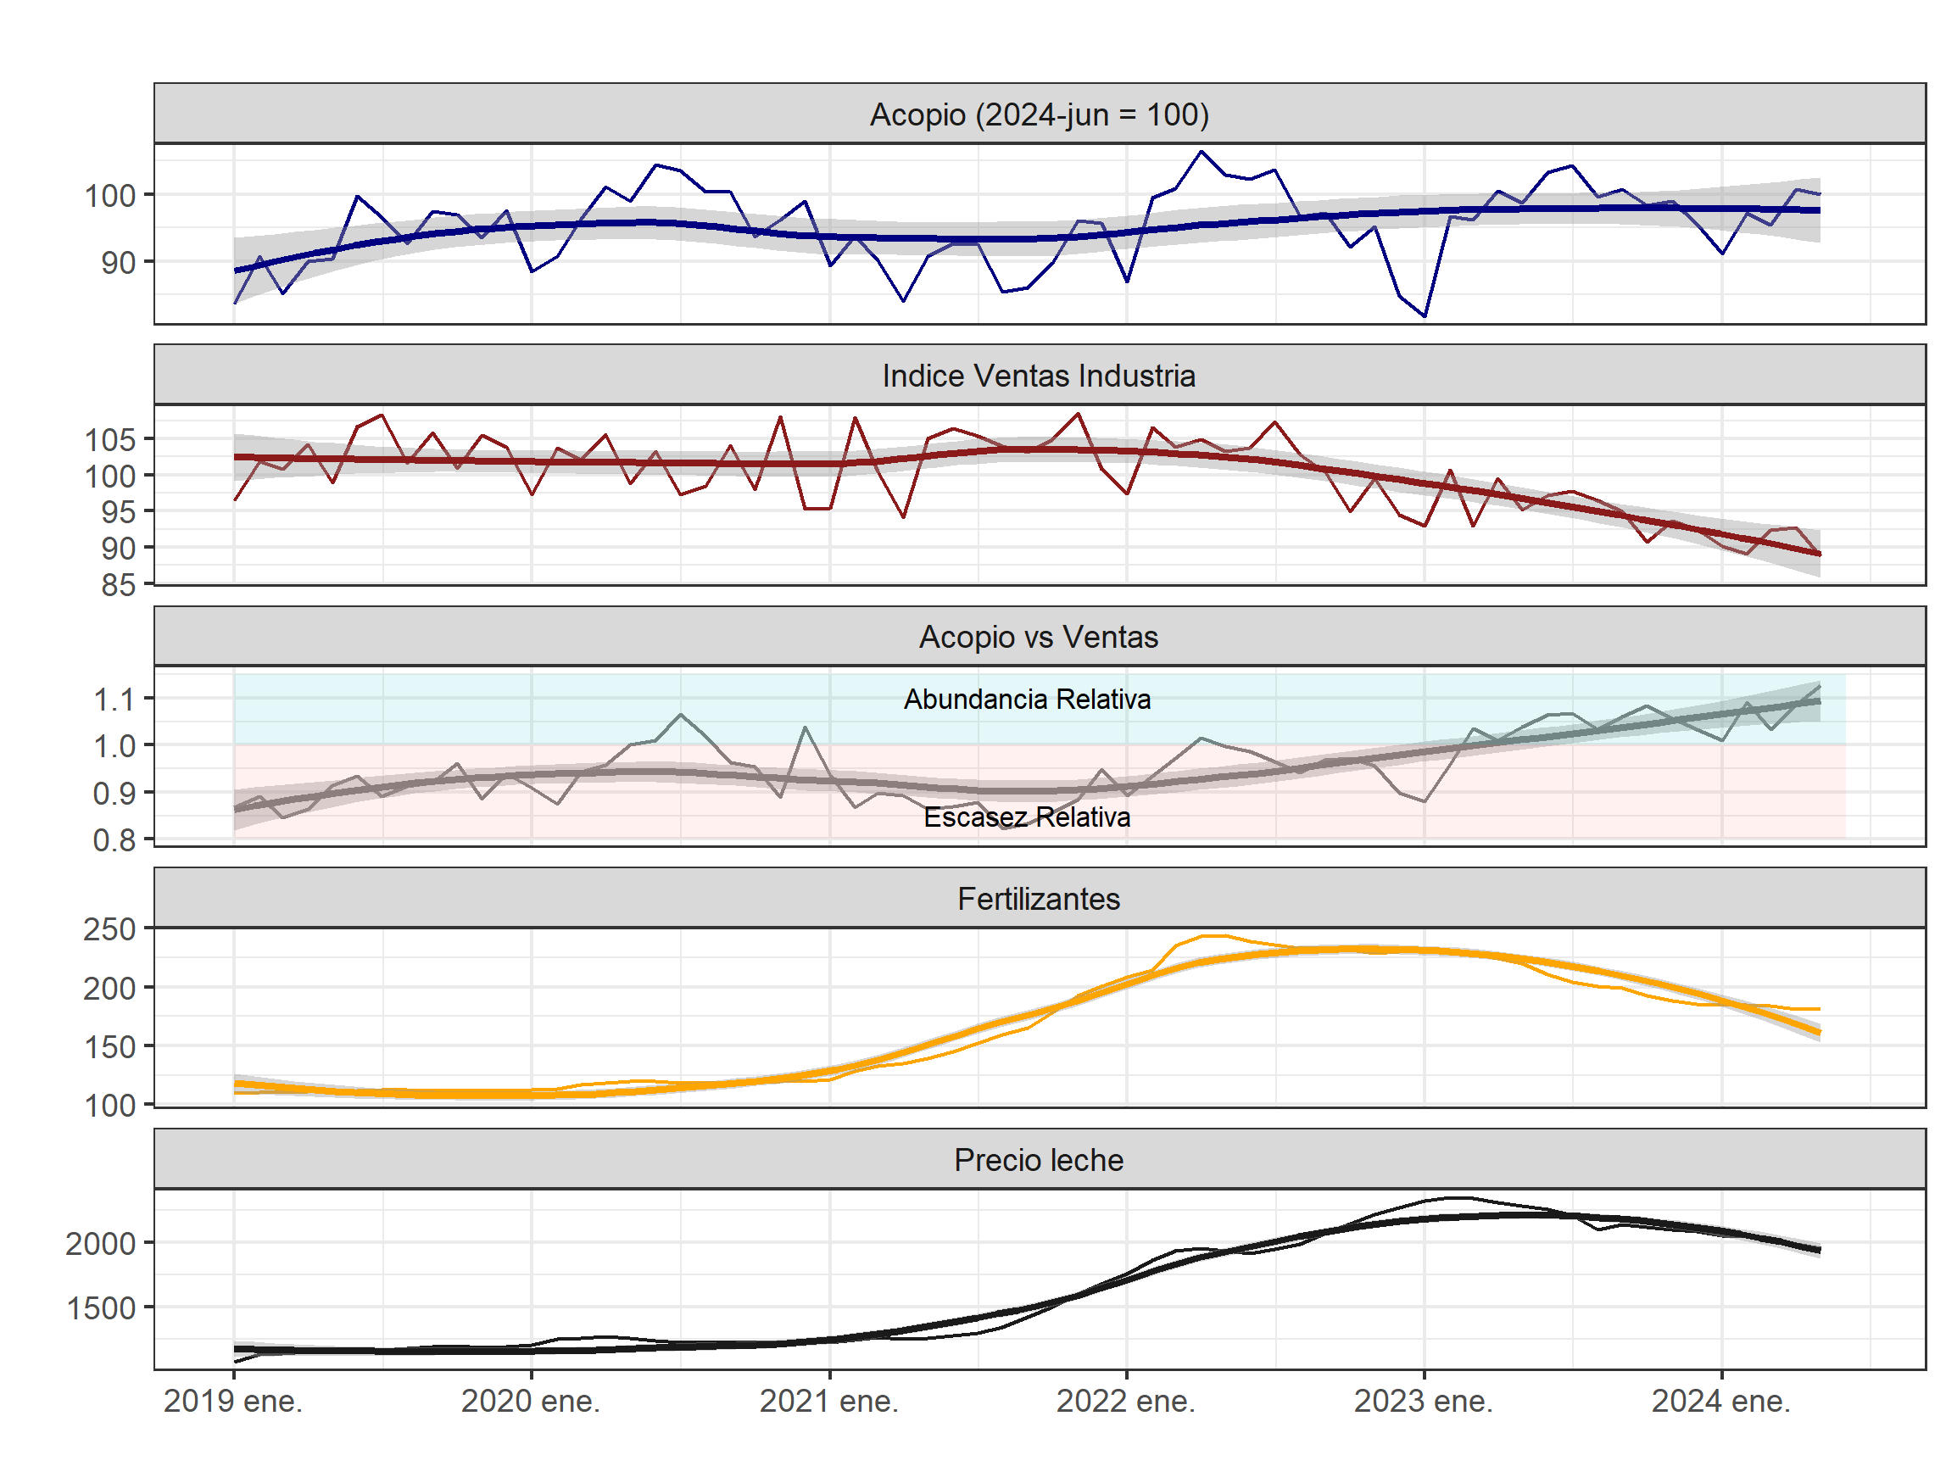
Revisiting 2021–2024: What the Model Tells Us
The model helps us understand the raw milk price dynamics observed over the past few years:
2021:
Fertilizer prices began to climb—doubling over the year. Milk collection dropped, while demand peaked by year-end. → This combination of higher costs and relative scarcity triggered a sharp price increase.
2022:
Fertilizer prices continued to rise, reaching a peak by year-end. At the same time, milk collection recovered and demand began to decline. → These trends eased the upward pressure on prices.
2023:
Fertilizer prices fell, milk collection remained stable, and demand dropped by 8.5%. → This led to strong downward pressure on raw milk prices.
2024 (YTD):
Fertilizer prices continue to decline, alongside ongoing reductions in dairy demand. → Together, these factors are intensifying downward price pressures.

Slide 17
Key Takeaways & Strategic Implications
Raw milk prices are highly sensitive to input costs Especially fertilizers and feed. Fertilizer price shocks show immediate and significant effects on milk pricing.
Demand dynamics amplify price movements Sharp increases in dairy demand—combined with constrained supply—create upward pressure. When demand weakens, the opposite occurs.
Secondary inputs (e.g., antibiotics) have limited individual impact Their effect on price is modest, even under significant cost variation.
The Collection-to-Sales ratio is a reliable indicator of price pressure It captures relative scarcity and reflects the balance between supply and market demand.
The post-2021 price surge was not random It can be explained by simultaneous cost increases, supply constraints, and demand growth—exactly the conditions modeled.
Current trajectory (2023–2024) points to continued downward pressure Unless there’s a reversal in demand trends or a new cost shock, prices are likely to remain under pressure.

